Slide 1
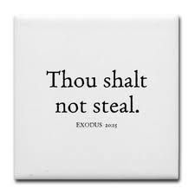
Living the 10 Commandments
Commandment VIII: Do not steal

Slide 2
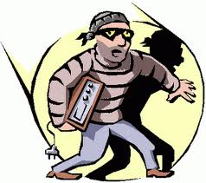
Some examples
Armed robbery
Shoplifting
Keeping something you find instead of turning it in to lost and found
Plagiarism or cheating on an exam
Selling or returning something that is damaged as though it were not
Copying software or movies
Selling (or knowingly buying) something with a false brand name
Using company supplies for personal use without permission
Wasting time at work or taking time off under false pretenses

Slide 3
Justification
Everyone does it – stealing cable or software piracy
No one will know
We aren’t really hurting anyone
They are rich (could refer to a corporation)
Revenge
It can’t be wrong because I am taking something good – Taking an Agpeya from church
It’s not wrong because if I asked, they would have given it to me

Slide 4

Stealing in the media
The media romanticizes thieves stealing from the rich, criminals, or people with bad attitudes
Ocean’s Eleven
Desensitized to stealing
Psalm 50:16-18
But to the wicked God says: "What right have you to declare My statutes, Or take My covenant in your mouth, Seeing you hate instruction And cast My words behind you? When you saw a thief, you consented with him, And have been a partaker with adulterers.

Slide 5
Reasons to steal
Need (poverty or imagined poverty)
Proverbs 30:8-9
Remove falsehood and lies far from me; Give me neither poverty nor riches-- Feed me with the food allotted to me; Lest I be full and deny You, And say, "Who is the LORD?" Or lest I be poor and steal, And profane the name of my God.
We think we have a right to the thing stolen (Foreclosed home)
We think that no one will be hurt when we steal (Software)
To hurt someone else: Example – stealing another person’s reputation

Slide 6
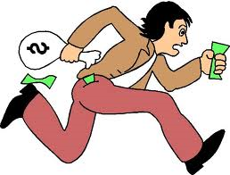
What does stealing say about me?
Filled with lust and greed
Lack of love
Lack of accountability
Lack of contentment
I don’t have faith that God will provide

Slide 7

Filled with lust and greed
Focus is on the material thing.
This is more important to me than obeying God.
Matthew 6:21
For where your treasure is, there your heart will be also.
Psalm 62:10
Do not trust in oppression, Nor vainly hope in robbery; If riches increase, Do not set your heart on them.

Slide 8
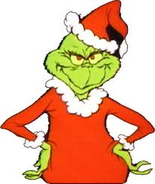
Lack of love
How can I love someone that I steal from?

Slide 9
Lack of accountability
I think that God does not notice
Hebrews 4:13 - And there is no creature hidden from His sight, but all things are naked and open to the eyes of Him to whom we must give account.
Or if He does notice, He does not consider what I do to be wrong
Mark 7:21-23 - For from within, out of the heart of men, proceed evil thoughts, adulteries, fornications, murders, thefts, covetousness, wickedness, deceit, lewdness, an evil eye, blasphemy, pride, foolishness. All these evil things come from within and defile a man."

Slide 10
Lack of accountability
Or even if it is wrong, He will understand and not condemn me
Job 21:30
For the wicked are reserved for the day of doom; They shall be brought out on the day of wrath.

Slide 11

Lack of contentment
I steal to obtain something that I think will satisfy me or make my life easier
My eye is always looking at what others have

Slide 12

I don’t have faith that God will provide
If I expected God to give me what I need, I wouldn’t feel I had to steal to obtain it

Slide 13
Stealing from God
Malachi 3:8-9
"Will a man rob God? Yet you have robbed Me! But you say, "In what way have we robbed You?' In tithes and offerings. You are cursed with a curse, For you have robbed Me, Even this whole nation.
How do we steal from God?

Slide 14
Do we take stealing seriously?
Jeremiah 7:9-11
Will you steal, murder, commit adultery, swear falsely, burn incense to Baal, and walk after other gods whom you do not know, and then come and stand before Me in this house which is called by My name, and say, "We are delivered to do all these abominations'? Has this house, which is called by My name, become a den of thieves in your eyes? Behold, I, even I, have seen it," says the LORD.
What do we have to say before God when stand in His house?

Slide 15
Thanksgiving
Do we thank God for all that He does for us?
Or do we think that we get through our day by our own strength?
Colossians 4:2
Continue earnestly in prayer, being vigilant in it with thanksgiving;
How much of our prayers or focused on ourselves or asking God for things?

Slide 16
Praise
Do we remember the character of God and praise Him for who He is?
Do we give God credit for all the creation He has made?
Midnight Praises is a time to remember and glorify the greatness of God. It is not an optional service made just for deacons to practice their chanting.

Slide 17

Tithes
Do we feel that our money and our possessions belong to us?
Do I have a hard time giving my money or time to help others?
Do I feel that I am doing someone a favor by giving?
We are God’s servants. We give from what we are given.

Slide 18
The sabbath
Do we give God His day?
Do we place higher importance on working and earning money on this day?
Exodus 16:4-5,26
Then the LORD said to Moses, "Behold, I will rain bread from heaven for you. And the people shall go out and gather a certain quota every day, that I may test them, whether they will walk in My law or not. And it shall be on the sixth day that they shall prepare what they bring in, and it shall be twice as much as they gather daily.“…Six days you shall gather it, but on the seventh day, the Sabbath, there will be none."

Slide 19
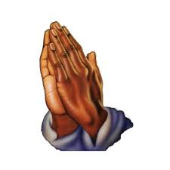
Worship time
Liturgies
Praises
Pascha
Any church activities
These exist for us to enjoy and partake of

Slide 20
What does stealing from God say about me?
Filled with lust and greed
  I use my time for myself rather than giving it to God
  I believe my time is my own, not a gift from Him
Lack of love
  I show a lack of love and appreciation toward God when I do not give Him what is due Him
Lack of accountability
  I believe that God doesn’t care when I don’t pray or miss a Liturgy

Slide 21
What does stealing from God say about me?
Lack of contentment
  I steal what belongs to God because I really don’t fear Him or I don’t see that He is good
  Therefore I am not enthusiastic or content with following Him or waiting upon His timing
I don’t have faith that God will provide
  I don’t have patience to wait for God to reveal Himself
  I don’t believe that God really will help me enjoy a deep spiritual life with Him

Slide 22
Stealing always comes with lying
Physical stealing – lying to conceal what I did
Stealing from God
  Lying about my motivations or intentions to come to church, etc
  Lying to myself about not having the time to devote to Him

Slide 23
Solution
Ephesians 4:28
Let him who stole steal no longer, but rather let him labor, working with his hands what is good, that he may have something to give him who has need.
Application:
  Honest labor to support ourselves – giving God a chance to bless our work
  Giving – Trusting that God is the provider and will bless us when we share what we have with others
  Labor in our spiritual life – Giving and serving to others

Slide 24
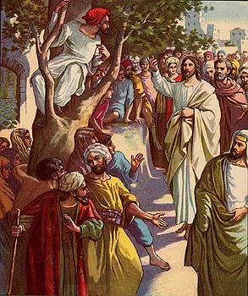
Zacchaeus
Luke 19:8
Then Zacchaeus stood and said to the Lord, "Look, Lord, I give half of my goods to the poor; and if I have taken anything from anyone by false accusation, I restore fourfold."
He was SERIOUS in correcting his mistakes
And was willing to suffer LOSS to make things right
That is the sign of a truly repentant heart

Slide 25
The end of a thief
Proverbs 20:17
Bread gained by deceit is sweet to a man, But afterward his mouth will be filled with gravel.
Stealing seems to bring success initially, but ultimately disaster
Examples: Enron executives, Bernie Madoff

